Slide 1
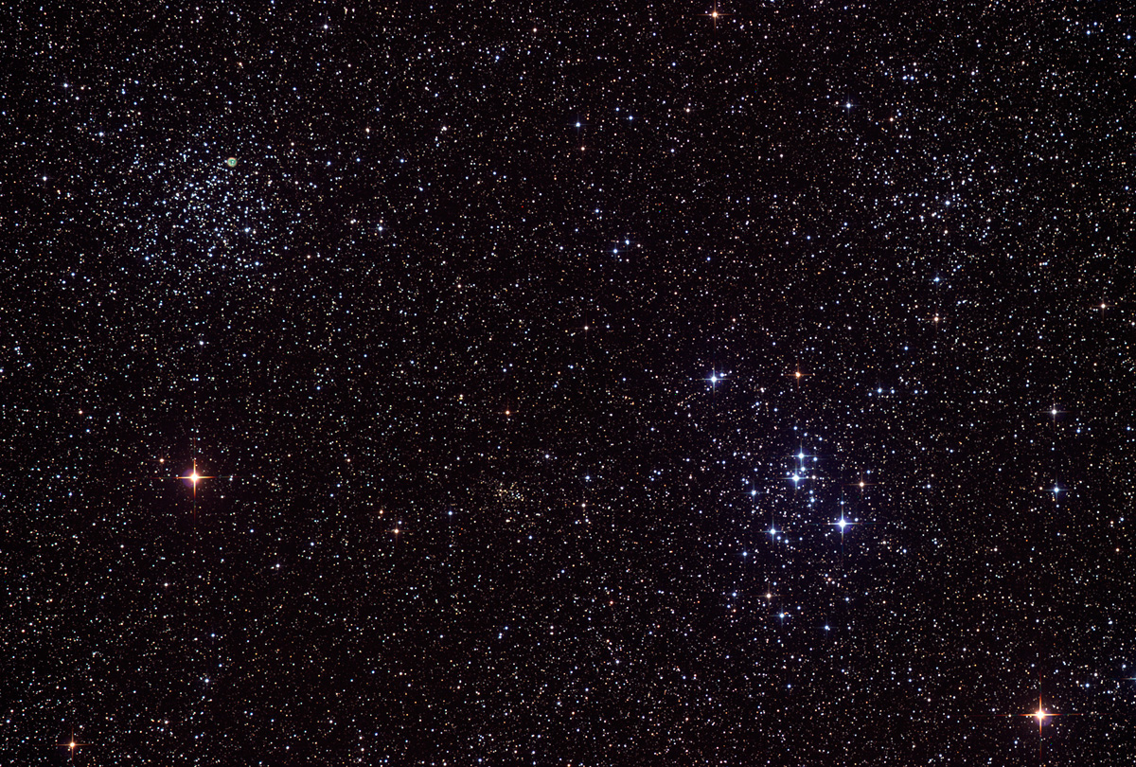

Astroschool:
Filters
14
January 16th, 2014
Notes:
How do you prepare for an observing session so that it is enjoyable, productive, and relatively stress free?

Slide 2
Astronomical filters
Filters block unwanted light
In doing so, they increase contrast

Slide 3
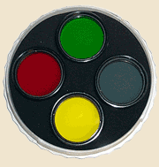
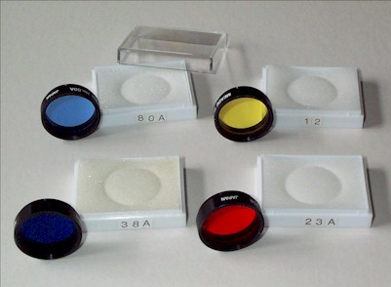
Astronomical filters

Slide 4
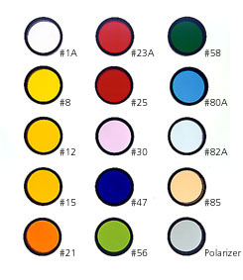
Astronomical filters
Kodak's Wratten series can be purchased in over a hundred colors and densities and can be mounted in slide mounts and simply held between the eyepiece and the eye.

Slide 5
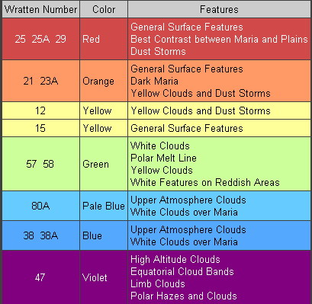
Astronomical filters

Slide 6

White-light solar filters

Slide 7
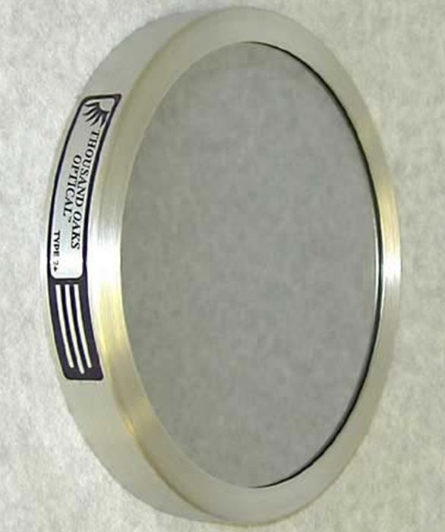
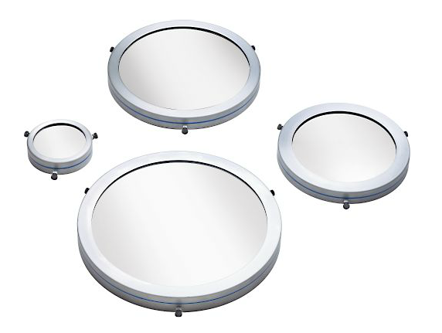
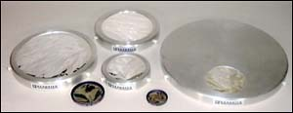
White-light solar filters

Slide 8
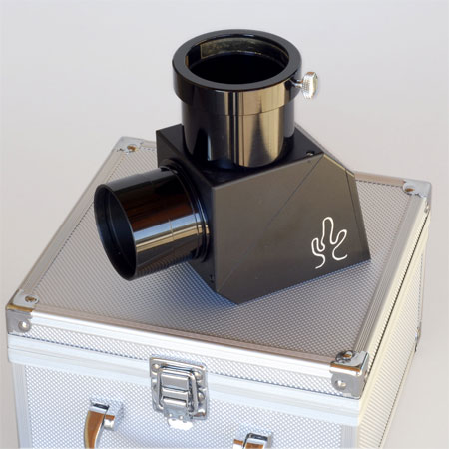
White-light solar filters
Notes:
Herschel wedge

Slide 9
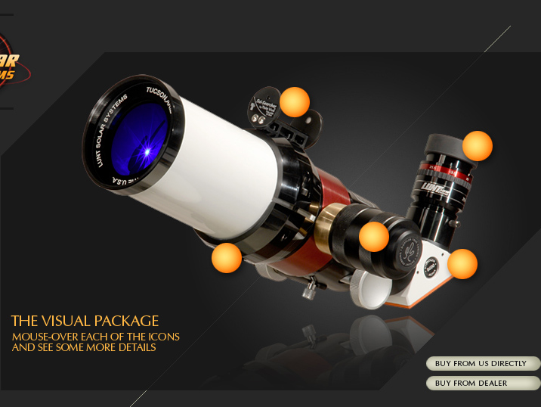
Hydrogen-alpha solar filters
Notes:
Lunt LS-60

Slide 10
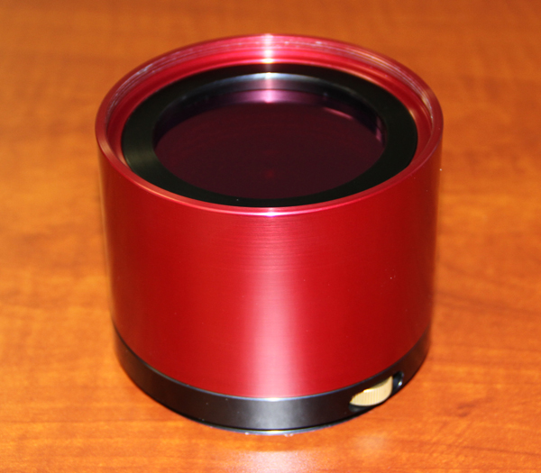
Hydrogen-alpha solar filters
Notes:
Lunt LS-60

Slide 11
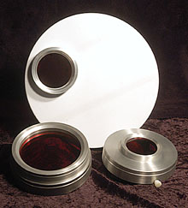
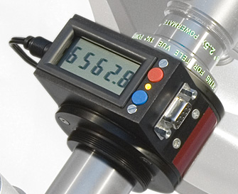
Hydrogen-alpha solar filters
Notes:
Lunt LS-60

Slide 12
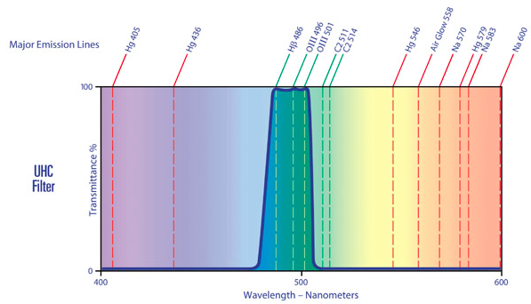
Astronomical filters

Slide 13
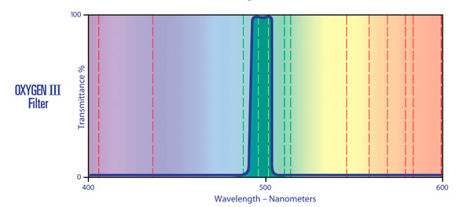
Astronomical filters

Slide 14
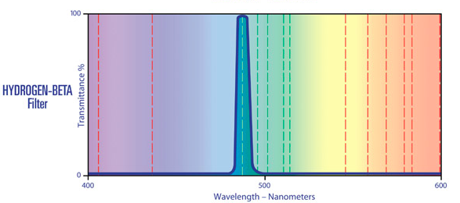
Astronomical filters

Slide 15
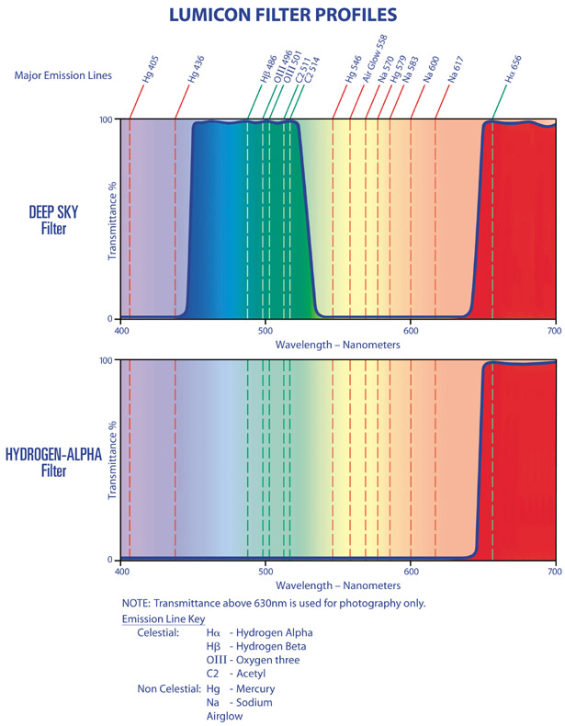

Slide 16
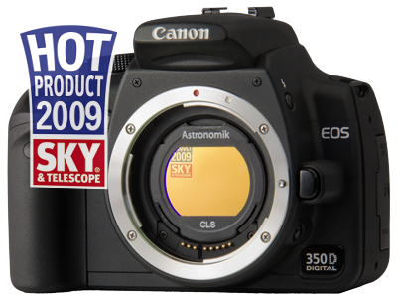
Astronomik EOS clip-in

Slide 17
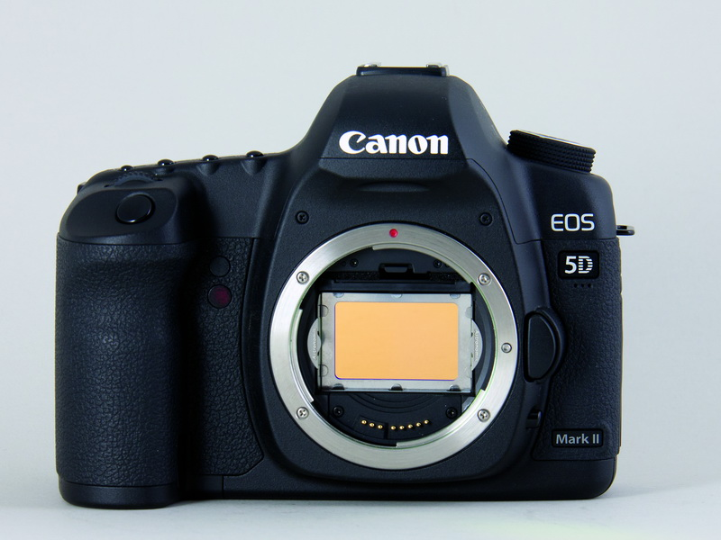
Astronomik EOS clip-in

